Slide 1

Overview of User Experience (UX), Tools and Resources
User Experience

Slide 2
Overview
What is UX?
What Situations Would Benefit From UX Design?
Important Points To Consider About UX Design
Tasks And Techniques Of UX Designers
Tools of the trade

Slide 3
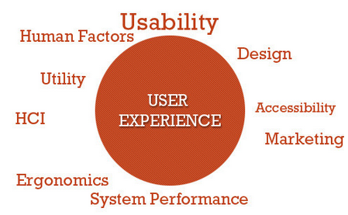
What is a User Experience (UX)?
“user experience” was coined by Dr. Donald Norman
User experience is how a person feels when interfacing with a system.
UX designers study the system, sub-systems and processes.

Slide 4
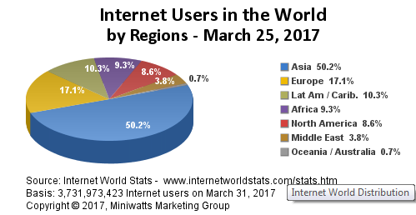
Why Is UX Important?
Before we answer this, let us think of how many people we are talking about

Slide 5
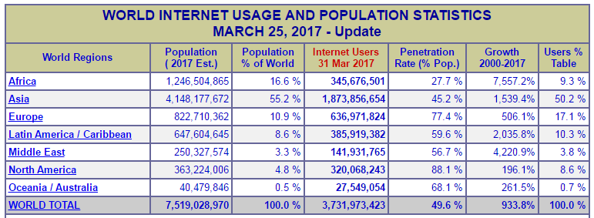
Why Is UX Important?
Before we answer this, let us think of how many people we are talking about

Slide 6
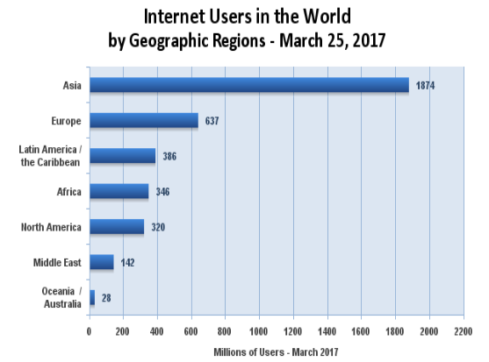
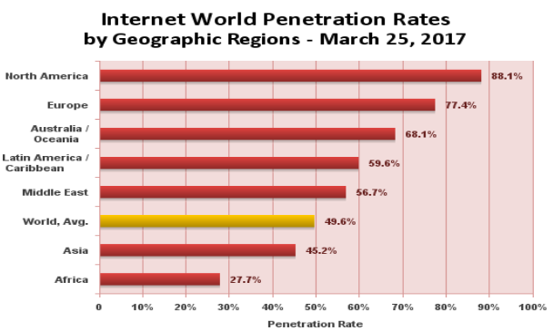
Why Is UX Important?

Slide 7
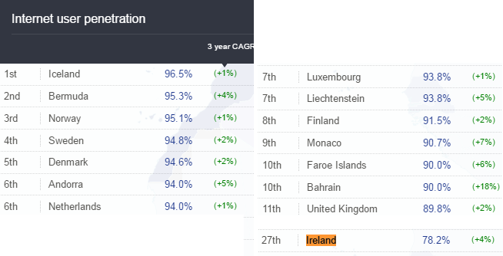
Why Is UX Important?
https://en.wikipedia.org/wiki/Global_Internet_usage

Slide 8
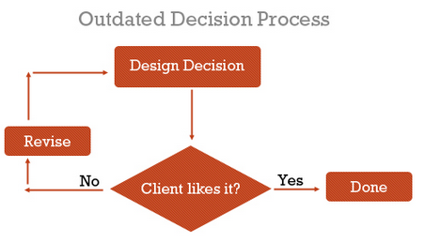
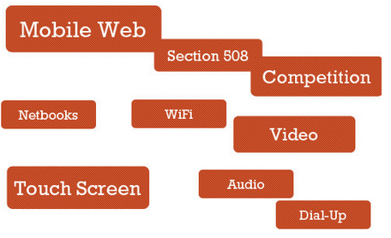
Why Is UX Important?
Educate designers of the past
Built interactions on what we thought worked and looked good

Slide 9
What Situations Would Benefit From UX Design?
All web systems would benefit from a solid evaluation!
Some of the major categories would be;
  Complex systems
  Start-ups
  Projects with “OK” budgets
  Projects with longer timeframes

Slide 10
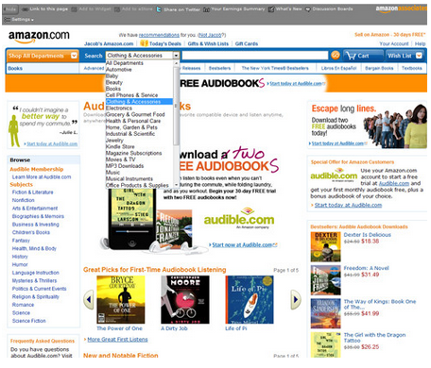
What Situations Would Benefit From UX Design?
Complex Systems
Systems that involve a myriad of user tasks must be perceived as being valuable, pleasant and efficient. Designers risk big losses in revenue by neglecting the user experience.

Slide 11
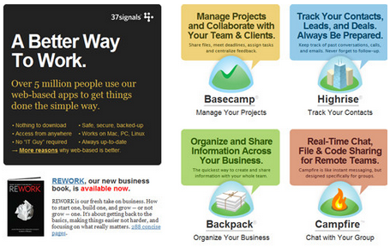
What Situations Would Benefit From UX Design?
2. Start-ups
37Signals, a lean start-up company that builds highly successful and robust Web applications, including Basecamp and Highrise, relies on well-rounded individuals, people who can “wear different hats.”

Slide 12

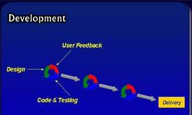
What Situations Would Benefit From UX Design?
Projects with “OK” budgets
  Medium or small companies may not have resources
Projects with longer timeframes
  More scope here for UX designers due to possible user interactions and project length

Slide 13
Important Points To Consider About UX Design
UX design is an amazing discipline, but it cannot accomplish certain things.
  UX Design is not one size fits all
  Cannot be directly assessed with traditional metrics
  Not the same as usability
Criticisms of UX as a profession
  Adds expense - http://www.uie.com/articles/three_hund_million_button/
  Yes another thing to worry about
  Results are not directly measureable

Slide 14
Tasks And Techniques Of UX Designers
Evaluation of current system
A/B testing
User surveys
Wireframes and prototypes
User flows
Storytelling - http://uxdesign.smashingmagazine.com/2010/01/29/better-user-experience-using-storytelling-part-one/
User profiles and personas - http://boxesandarrows.com/building-a-data-backed-persona/
Content Inventory
Content Style guides - http://www.smashingmagazine.com/2010/07/21/designing-style-guidelines-for-brands-and-websites/
We will look at some of these now….

Slide 15
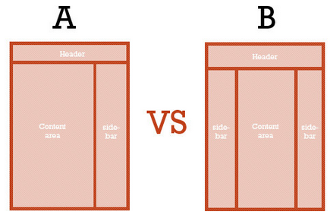
A/B Testing
A UX specialist might devise a study to compare the effectiveness and quality of experience of different user interfaces.

Slide 16
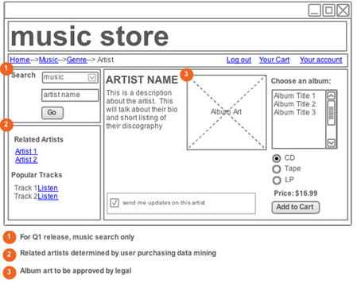
Wireframes and prototypes
Based on their findings, UX specialists might develop wireframes of different layouts and perhaps also higher-fidelity prototypes.

Slide 17
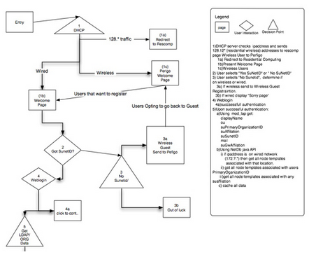
User flows
Designing how users should move through a system is another popular deliverable – WHY?

Slide 18
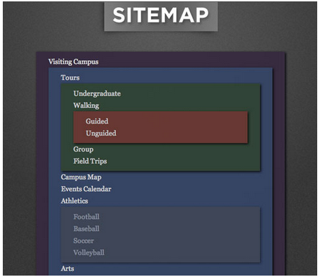
Content Inventory
an organized list of pages on a website.
Doing a content inventory is a step towards proposing changes in information architecture to enhance the user experience (e.g. user flow, findability and efficiency).

Slide 19
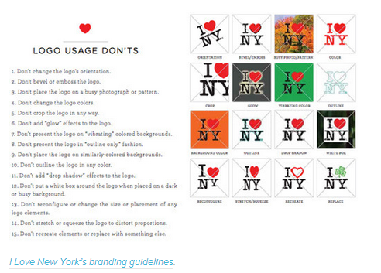
Content Style Guides
Consistency is critical to crafting a memorable user experience through your brand.
Content style guides give writers and designers a framework in which to work when creating content and developing a design, and they also ensure that the brand and design elements align with the owner’s goals.
http://www.smashingmagazine.com/2010/07/21/designing-style-guidelines-for-brands-and-websites/

Slide 20
Tools of the trade
Lets take a look at some of the applications that can help for below;
Wireframe and prototyping applications
A/B Testing software
Content Inventory software
User testing and feedback software
Analytics software

Slide 21
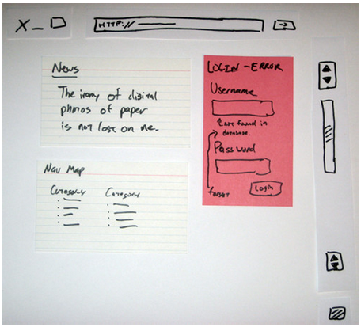
Wireframe and prototyping applications
Can be done simply with pen and paper.
Some software-based wireframing and prototyping tools are:
  OmniGraffle
  Balsamiq Mockups
  Mockingbird

Slide 22
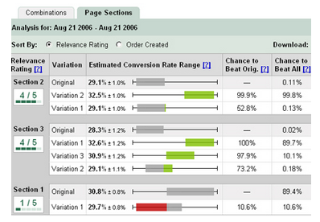
A/B Testing software
Compares different versions of a page.
A/B testing software splits a website’s traffic into two equal segments. One group sees version A, and the other group sees version B
Split testing determines which version is better based on these statistics. One of the most popular applications for A/B testing is Google’s Website Optimizer.

Slide 23
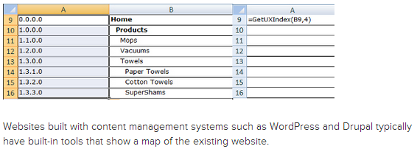
Content Inventory Software
There are plenty of methods of conducting a content inventory.
Using an on-site server application is best for production websites; being closer to the source than third-party software, these applications will naturally be more accurate and efficient.
You can use as simple a tool as Excel to create and manage a content inventory (check out the GetUXIndex() template).

Slide 24
User Testing and feedback Software
Interviewing users is another popular UX design task. The most effective and cost-saving way to do this is with a surveying or feedback app and remote user testing.
User feedback tools are abundant. General survey tools such as PollDaddy are flexible solutions that can be used for other tasks, too. There are usability-specific feedback tools, such as Usabilla, and remote user-testing services, such as Feedback Army, which administer usability tests on reviewers.

Slide 25
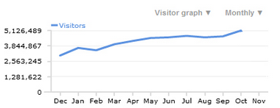
Analytics Software
UX designers can analyse traffic statistics to hypothesize what types of experiences would be most effective for the audience of the website.
Let’s say the data indicates that the most popular browser for a website is Google Chrome. Google Chrome is regarded as a power user’s browser (as opposed to Internet Explorer, which is more mainstream). From that assumption, a UX designer can craft user experiences that appeal to power users and tech-savvy people.
A feature-packed and free analytics tool is Google Analytics.

Slide 26
References
What Is User Experience Design? Overview, Tools And Resources
  http://uxdesign.smashingmagazine.com/2010/10/05/what-is-user-experience-design-overview-tools-and-resources/
Internet Usage Statistics
  http://www.internetworldstats.com/stats.htm

